Slide 1
Pacman
1 of 3

Slide 2
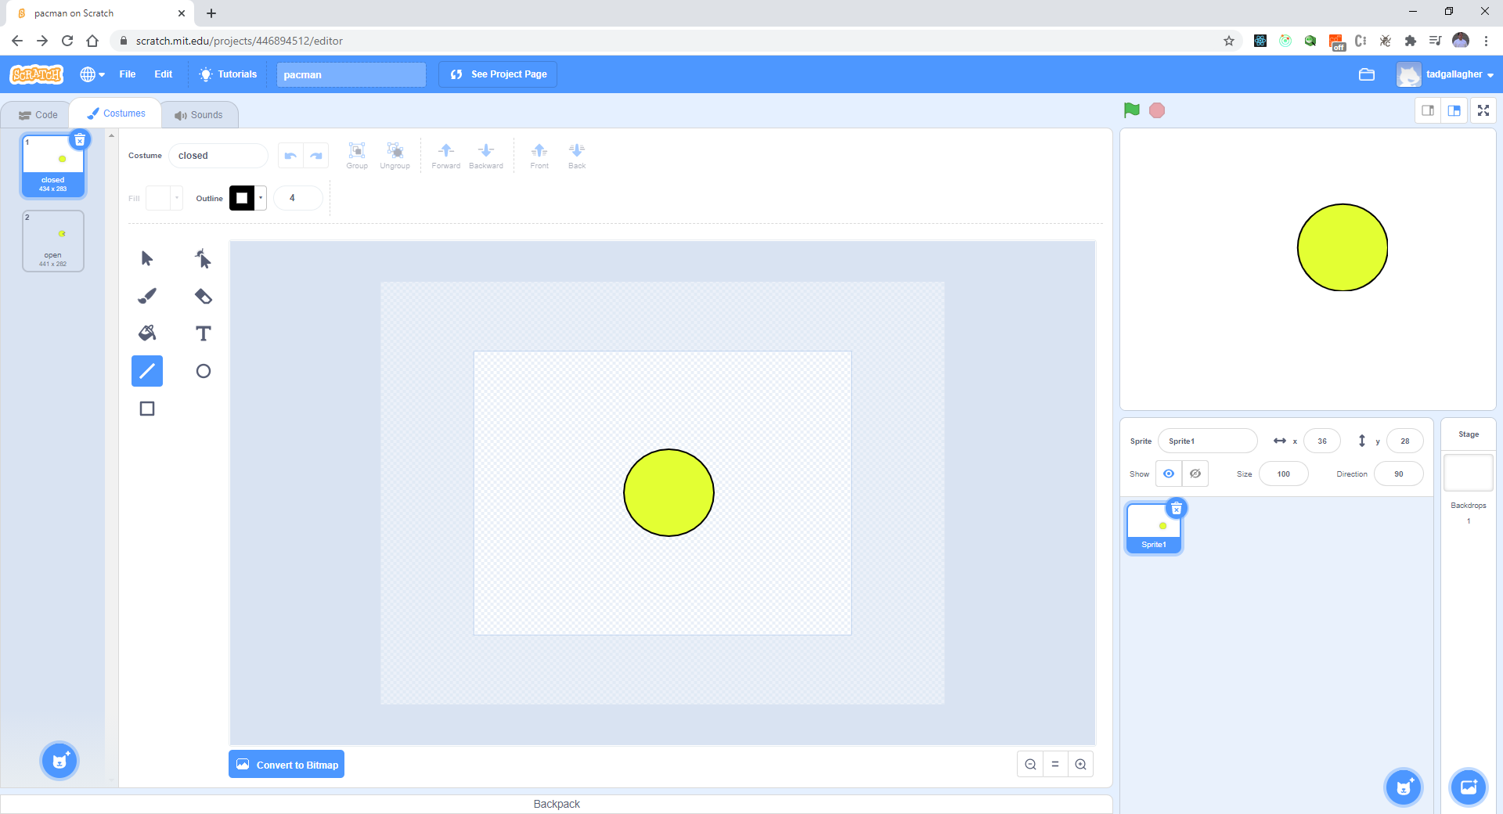
Create Pacman – 2 states
Open

Slide 3
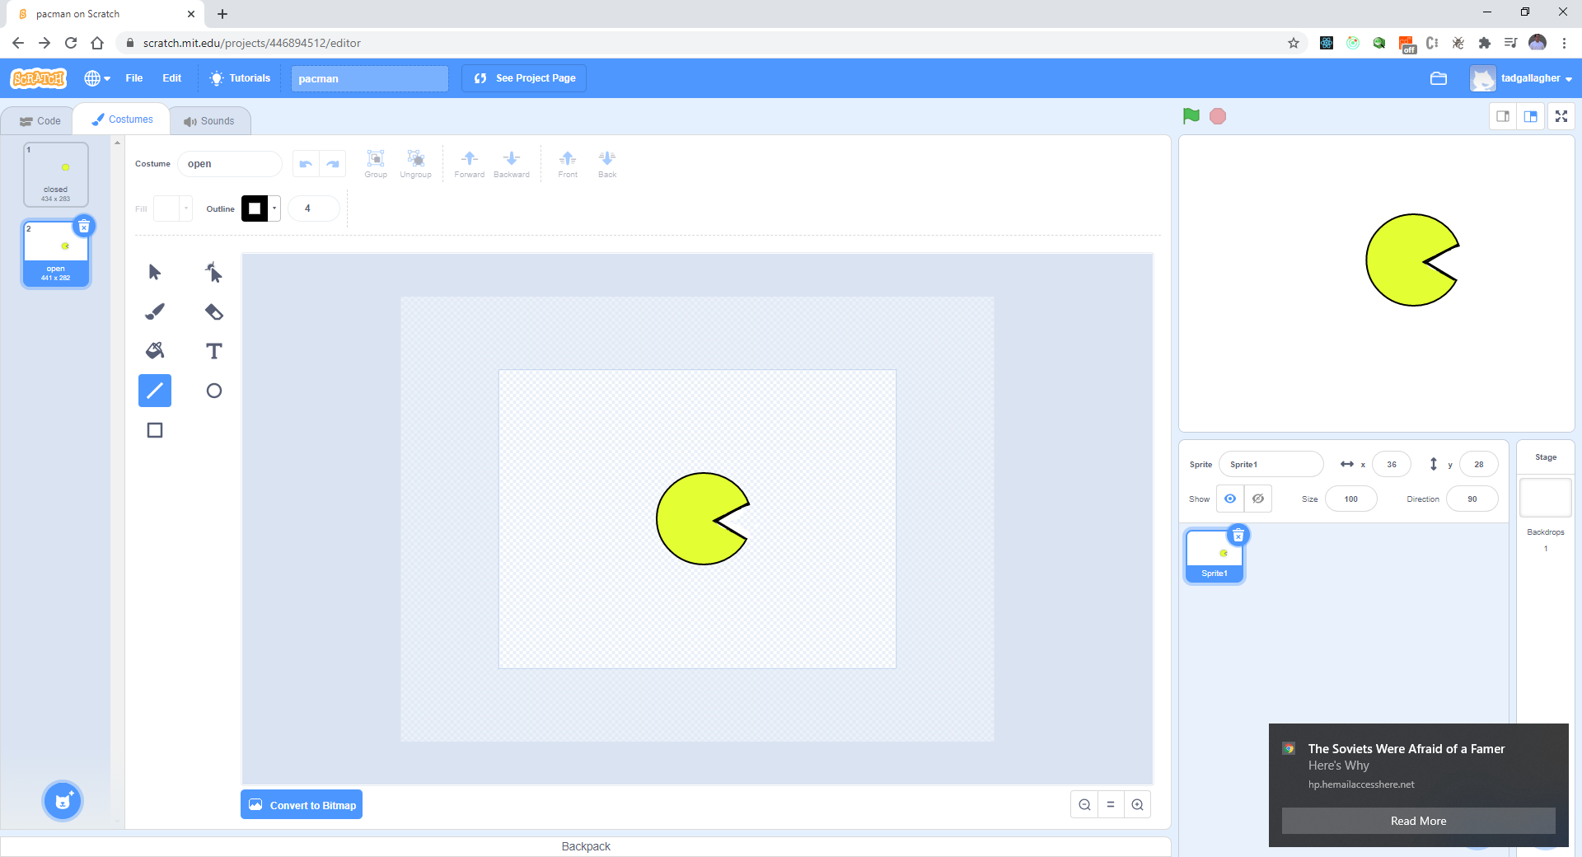
Closed

Slide 4
Download a Pacman map
https://wallpapersafari.com/w/u1a7Mb

Slide 5
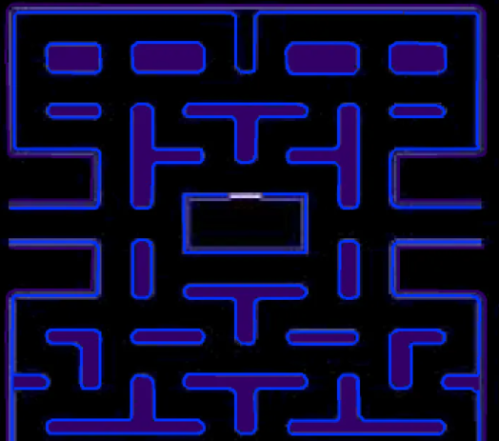
Pacman Map

Slide 6
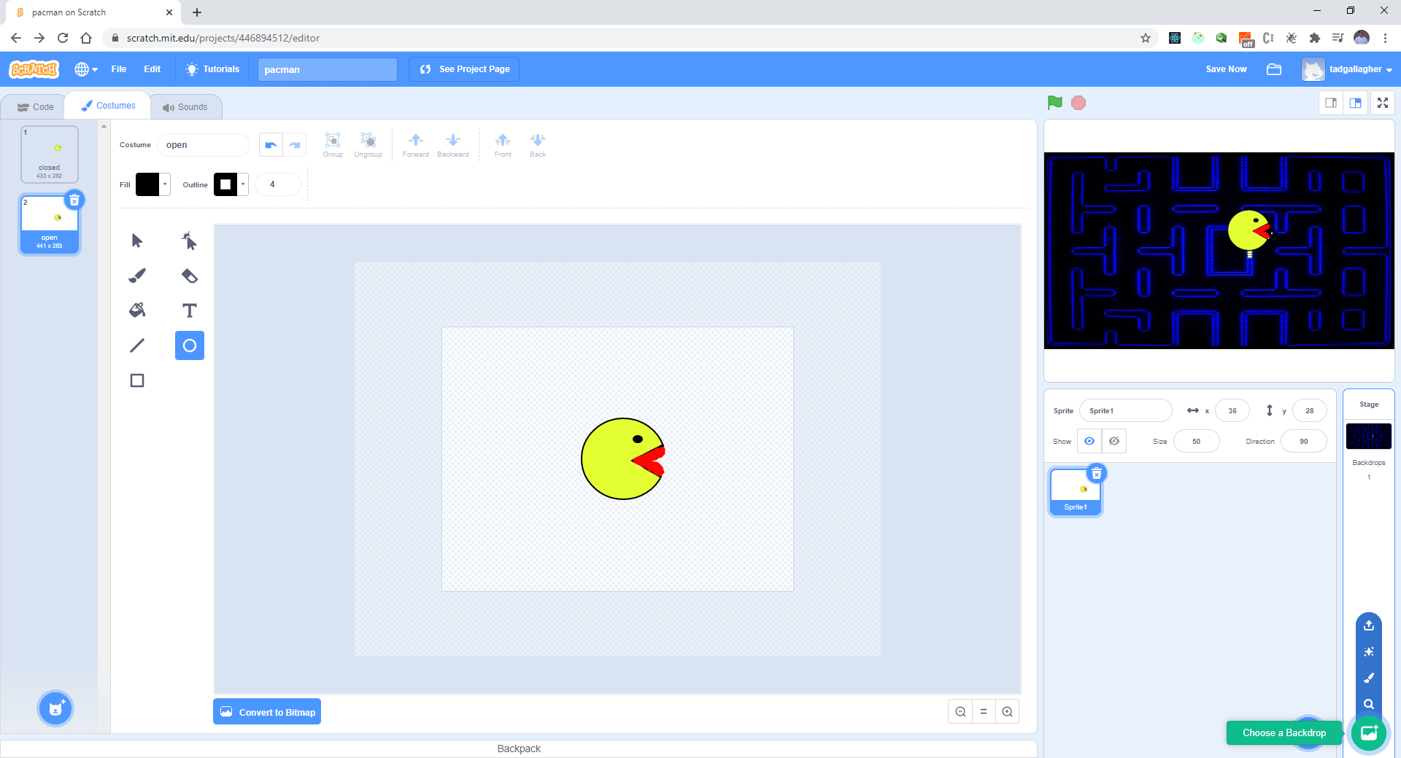
Upload to your workspace:

Slide 7
Create 5 variables for directions
Up
Down
Right
Left
direction

